Slide 1
Taxonomic classification of ants (Formicidae) from images using deep learning
Marijn JA Boer
marijn.boer@naturalis.nl
February 6th, 2018
Supervisor: dr. Rutger Vos

Slide 2
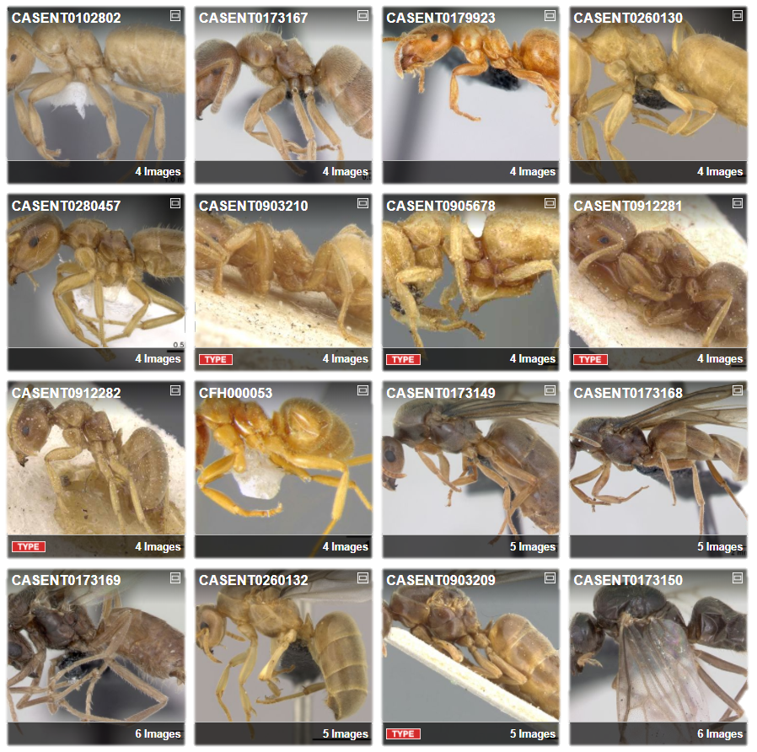
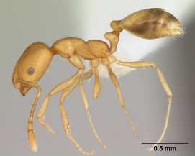
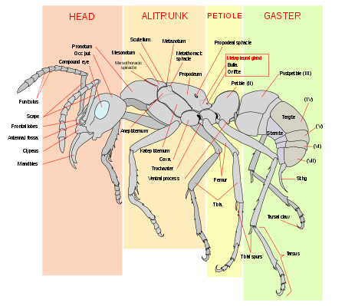
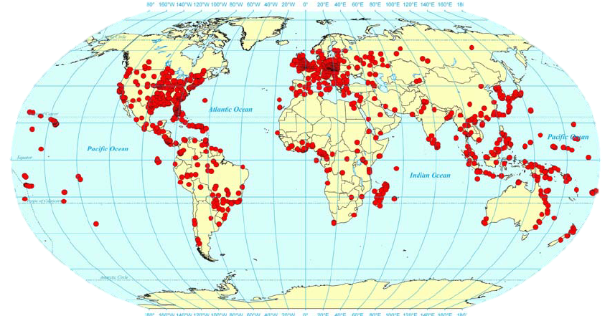
Ant Taxonomy
Global
Diverse
Identification
Monomorium pharaonis
Source: https://en.wikipedia.org/wiki/Ant
AntWeb. Available from: https://www.antweb.org/images.do?rank=species&name=flavus&genus=lasius. Accessed 31 January 2018
Wetterer JK. Worldwide spread of the pharaoh ant, Monomorium pharaonis (Hymenoptera: Formicidae). Myrmecological News. 2010;13: 115–129.
Photo by April Nobile / From www.antweb.org. Accessed 31 January 2018

Slide 3
Important to know the species
Need to know species because?
Important to ecosystems
Bioindicator
Richness surrogate?

Slide 4
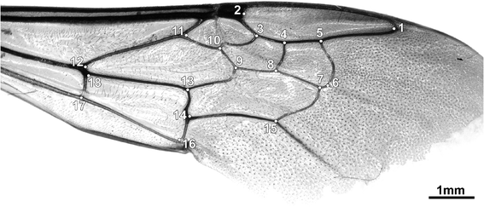
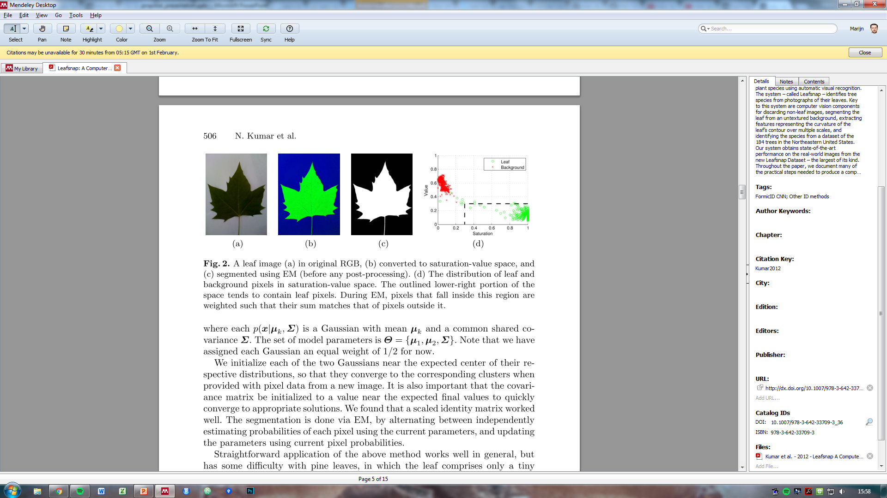
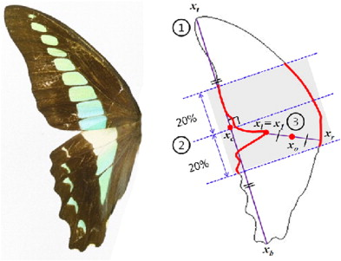
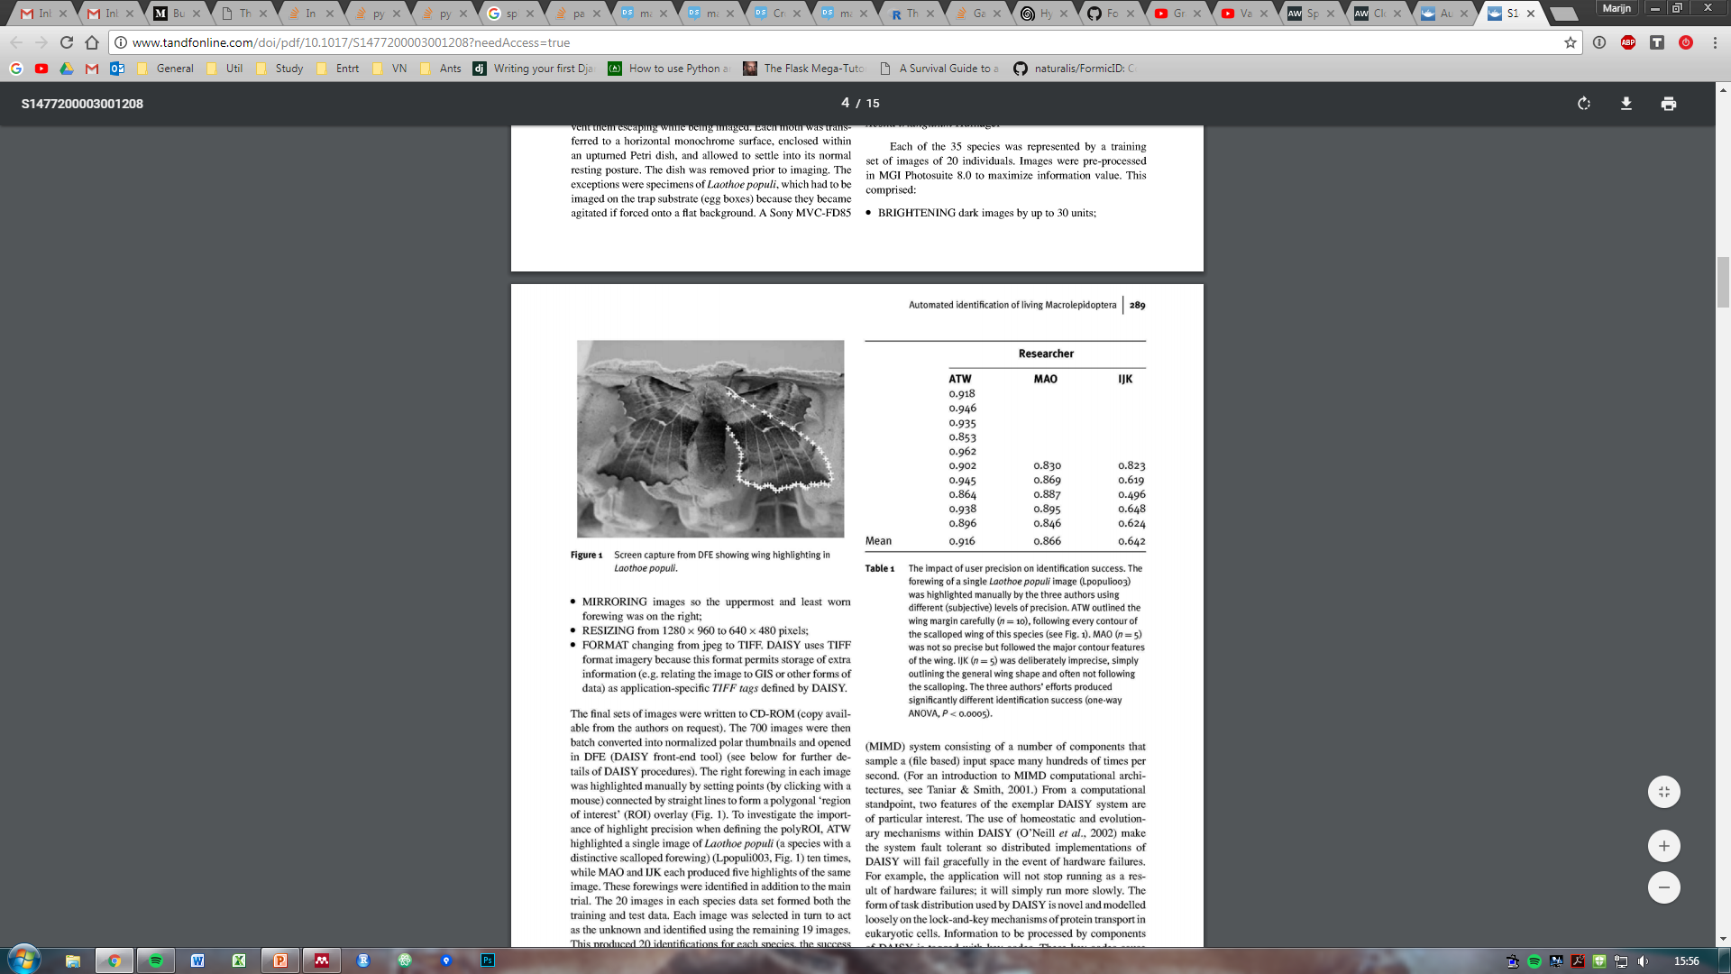
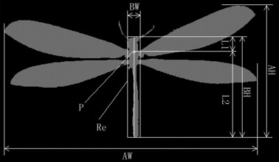
Computer vision
Machine learning
Features
Gerard, M. et al. Apidologie 46, 644–653 (2015)
Watson, A. T. et al. Syst. Biodivers. 1, 287–300 (2004)
Kumar, N. et al. in Computer Vision – ECCV 2012 502–516 (2012)
Kang, S.-H. et al. J. Asia. Pac. Entomol. 15, 431–435 (2012)
Wang, J. et al. Knowledge-Based Syst. 33, 102–110 (2012)

Slide 5
Examples
Previous research on these simple computer vision projects using machine learning.

Slide 6
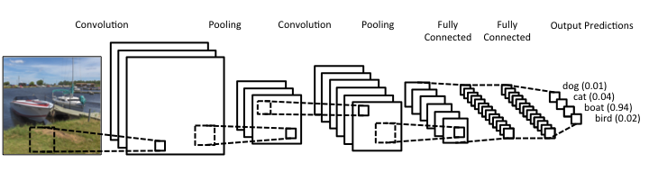
But… deep learning!
More promising
What is deep learning?
What is a CNN?

Slide 7
Example research using DL

Slide 8
FormicID Project
What is the aim of this project?
Naturalis aim
CNN multi-view

Slide 9
Questions

Slide 10
Problems

Slide 11
Approach
Scalable
Comprehensible
How to start?
Python

Slide 12
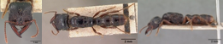
AntWeb

Slide 13
FormicID-97
DB summary

Slide 14
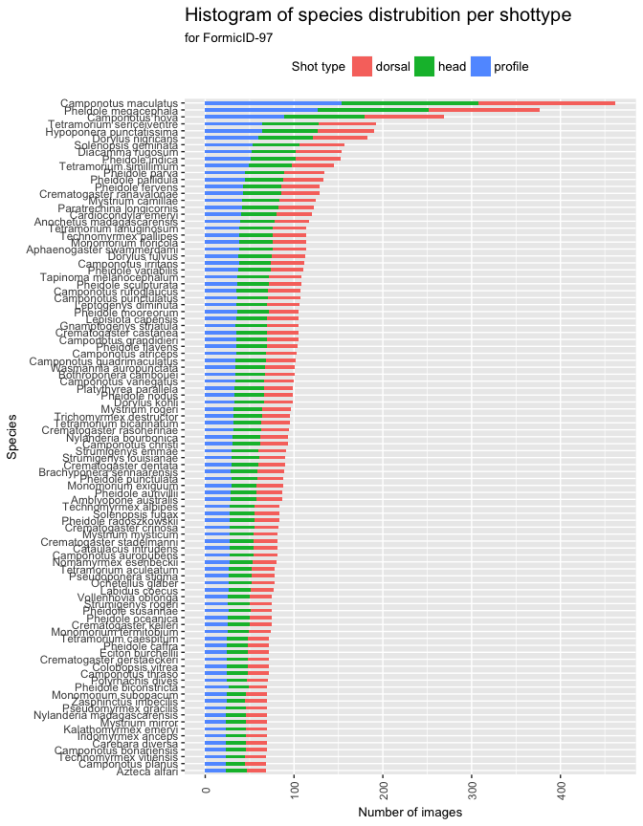
Species distribution
Switch axis!

Slide 15
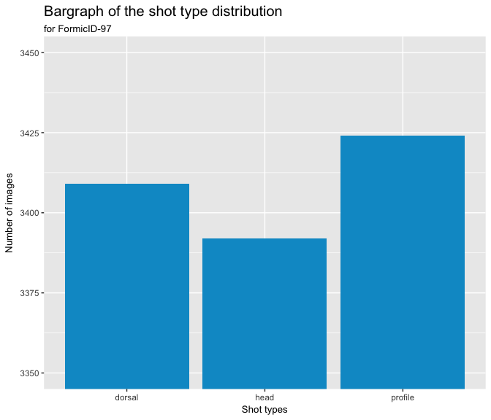
Shot type distribution

Slide 16
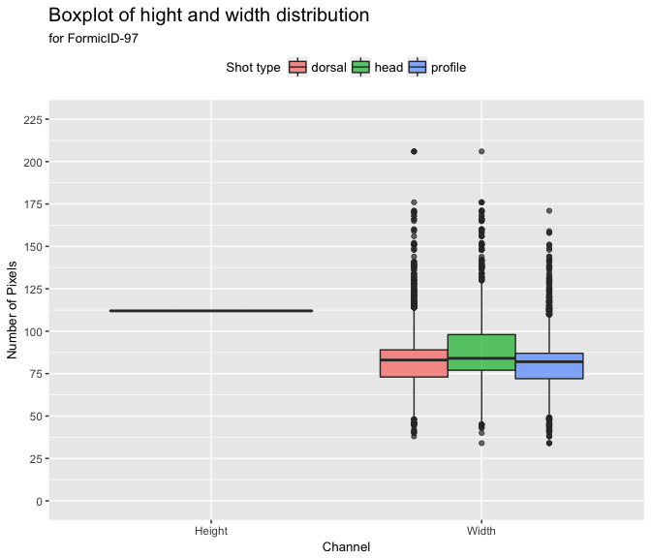
Image dimensions

Slide 17
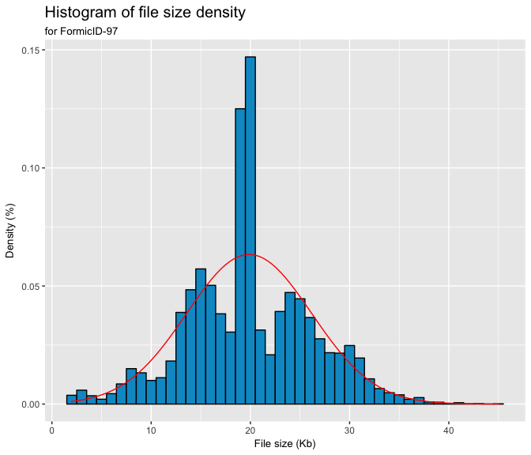
File size

Slide 18
Network architecture
Existing one
Examples…
…
New one
With these options:
…
…

Slide 19
Testing
First training
Validation
Then training
Top-1
Top-5
Then evalution of the results and increase complexity.

Slide 20
Timeline

Slide 21
Thanks!

